Slide 1
NBA
Starting 5 Predictions
Sheldon Yen

Slide 2
TABLE OF CONTENTS
01
03
02
04
Project Context and The Why?
Machine Learning
The Data and The Data Cleaning
Analysis

Slide 3
Project Context and The Why?
Group of Interest:
Starting 5 Lineups - Individual Statistics
- Productivity with other players in lineup
Factor to consider:
Usage Rate
- Team Statistic
- Low vs. Medium vs. High Usage Rate Players
Why:
Long fans of Basketball
- Watch Basketball
- Diehard Los Angeles Clippers Fan

Slide 4
The Data and The Data Cleaning
The Data:
Usage Calculation:
Balldontlie.io API
Player Data
Season Averages
100 * ((Field Goals Attempted + 0.44 * Free Throws Attempted + Turnover Rate) * (Total Team Minutes Played / 5)) / (Minutes Played * (Total Team Field Goals Attempted + 0.44 * Total Team Free Throws Attempted +Total Team Turnovers)).
Usage percentage is an estimate of the percentage of team plays used by a player while he was on the floor.
Data Cleaning:
Inner Merged datasets together by unique player ID
Removed all players that did not play in 2022
Calculated unique team statistics for each player
Calculated unique usage for each player

Slide 5
Machine Learning
MSE
Linear Regression | Simple Linear Regression using Usage and Points/Rebounds/Assists/Steals | 21.24
K-Nearest | Simple K-Nearest Regression using Usage and Points/Rebounds/Assists/Steals | 28.80
Multivariable Linear Regression | Multivariable Linear Regression using Usage/Weight/Height/Position and Points/Rebounds/Assists/Steals | 21.97
Multivariable K-Nearest | Multivariable K-Nearest Regression using Usage/Weight/Height/Position and Points/Rebounds/Assists/Steals | 26.35
Ensemble | Ensemble method using Voting Regressor of both the linear and k-nearest regressions | 22.26

Slide 6
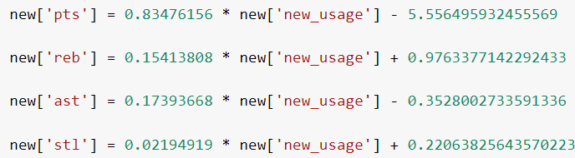
Regression Analysis
Variables of Interest:
Explanatory Variables - Usage Rate
- New Usage
Response Variables
- Points
- Assists
- Rebounds
- Steals

Slide 7
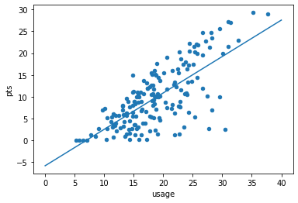
Regression Plot

Slide 8
Simulator
https://colab.research.google.com/drive/1DJP3kBH-CYCz-6JGP11btvMZONJu0ZjS?usp=sharing

Slide 9
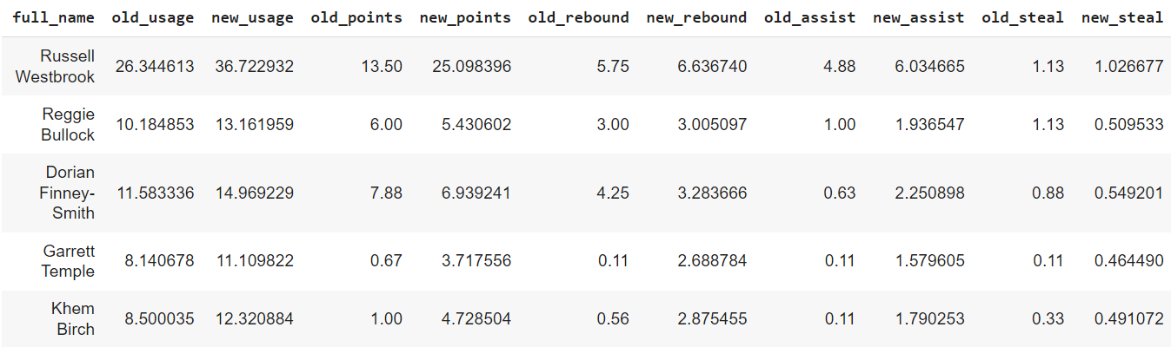
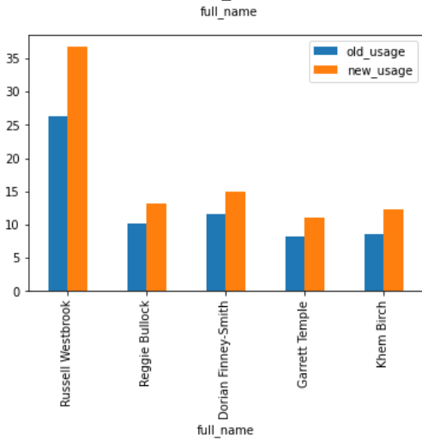
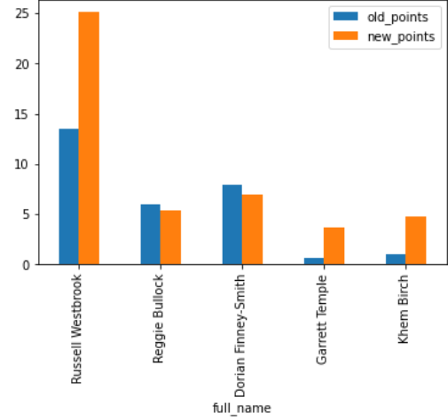
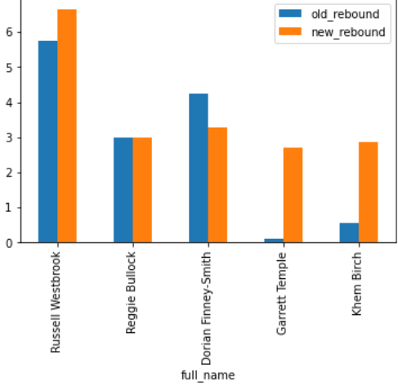
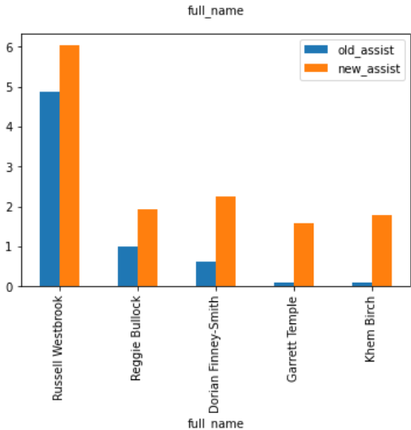
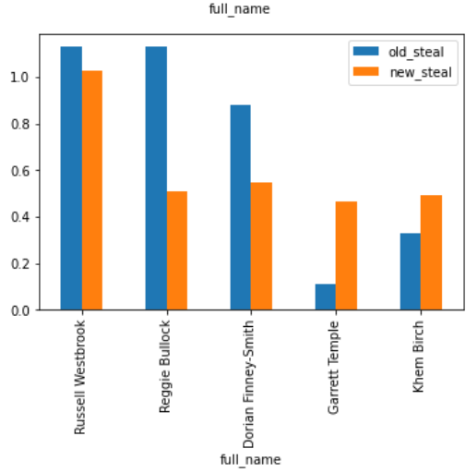
Russell Westbrook with Low Usage
Points

Slide 10
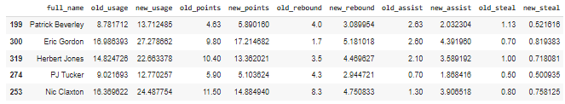
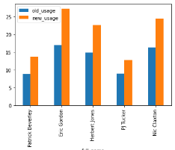
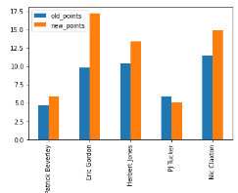
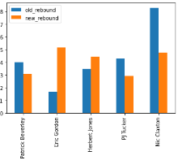
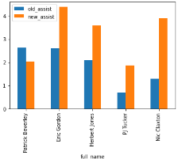
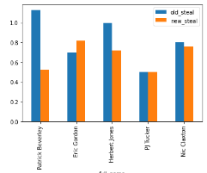
All Low Usage Player Lineup

Slide 11
Conclusion
Limitations:
- Lack of Access to Advanced Statistics
- Plus/Minus
- Per 48 Minute Statistics
- Limited Definition for Player Positions
- Players with abnormally high usage rates
- Lack of games
Observations:
- Good predictions overall from model with given resources
- High usage rate players favored
- Highest usage rate player has best individual statistics
- High usage rate players not optimal with other high usage rate players
- Low usage rate players see a jump with players with low/medium usage rates

Slide 12

Thank You and Happy Holidays!

